Slide 1

TO IMPLEMENT A SPAM EMAIL CLASSIFICATION
NAME DEPT/YR/SEC REG.NO
: A.AARON EBINEZER ARUN
: AI&DS /3rd/’A’
: 113222072002
SUBJECT NAME: STATISTICAL NATURAL LANGUAGE PROCESSING
SUBJECT CODE: 21AD315T
Objective / Scope (2) | Plan of Execution (2) | Implementation (2) | Presentation (2) | Insight on project area (2) | Total (10)

Slide 2
Module Details
Objective & Scope
Problem Statement
Plan of Execution
Module 1
Module 2
Module 3
Conclusion
Reference

Slide 3
Objective & Scope
Objective
To develop and implement a machine learning model capable of accurately classifying emails as spam or non-spam (ham), thereby improving email filtering systems and enhancing user experience.
Scope
This project involves collecting a dataset of labeled spam and ham emails, preprocessing the text data, and extracting relevant features. Various machine learning models will be developed and trained for classification.
The performance of these models will be evaluated using appropriate metrics, and the best-performing model will be implemented into an email filtering system. Comprehensive documentation of the process and findings will be provided.

Slide 4


Problem Statement
The project aims to develop a robust spam email classification model to accurately distinguish between spam and legitimate (ham) emails, enhancing email security and user experience. This involves collecting a comprehensive labeled dataset, preprocessing the data, and employing machine learning techniques to train and evaluate the model. The ultimate goal is to create a reliable system that minimizes the risks associated with spam emails, such as security breaches and productivity loss..

Slide 5
Plan of Execution
Data Collection: Obtain a dataset of labeled spam and ham emails.
Data Preprocessing: Clean the data by removing irrelevant information
and preprocessing the text (e.g., tokenization, stop-word removal).
Feature Extraction: Extract features from the text data using methods such as TF-IDF or word embeddings.
Model Development: Train a machine learning model using the prepared dataset.
Model Evaluation: Evaluate the performance of each model using metrics like accuracy, precision, recall, and F1-score.
Model Selection and Implementation: Select the best-performing model
and integrate it into an email filtering system.

Slide 6
Module 1
The first module focuses on the crucial step of data preprocessing, which prepares the raw email data for subsequent analysis and model training.
This involves several steps, including data cleaning, tokenization, normalization, and feature extraction. The Python program developed for this module handles tasks such as removing unnecessary characters and HTML tags, converting text to lowercase, and eliminating stop words. Additionally, it performs stemming or lemmatization to reduce words to their root forms. The preprocessed data is then transformed into a suitable format for machine learning algorithms, ensuring that the dataset is clean, consistent, and ready for effective model training and evaluation..

Slide 7
OUTPUT

Slide 8
Module 2
Feature Extraction and Selection
The second module is dedicated to feature extraction and selection, transforming the preprocessed text data into numerical features that can be used by machine learning algorithms
This involves techniques such as Term Frequency-Inverse Document Frequency (TF-IDF), word embeddings, or bag- of-words models to represent the text data in a structured format.
Additionally, feature selection methods will be employed to identify the most relevant features that contribute to distinguishing between spam and legitimate emails.
This step ensures that the model focuses on the most informative aspects of the data, improving its efficiency and accuracy in classifying emails.

Slide 9

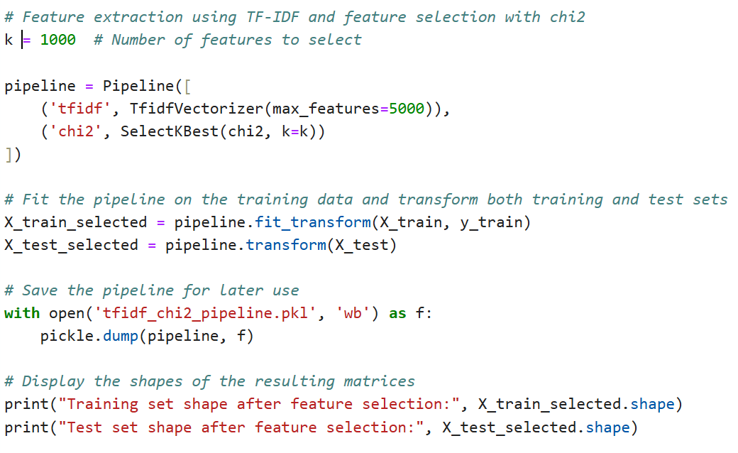
Module 2
Libraries used:
Code:
Output:

Slide 10
Module 3
Model Training and Evaluation
The third module focuses on training and evaluating various machine learning models for the spam email classification task.
This involves selecting suitable algorithms such as Naive Bayes, Support Vector Machines (SVM), Random Forest, or deep learning models like LSTM or CNN. The preprocessed and feature-engineered data from the previous modules will be used to train these models.
Hyperparameter tuning and cross-validation techniques will be applied to optimize the model performance.
The trained models will be evaluated using metrics such as accuracy, precision, recall, and F1-score to determine their effectiveness in correctly classifying emails as spam or legitimate.
The best-performing model will be selected for deployment in the final module.

Slide 11
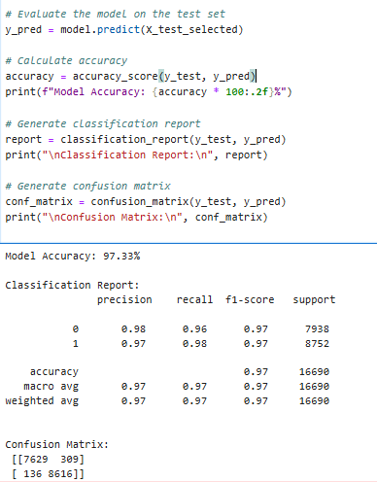
Module 3

Slide 12
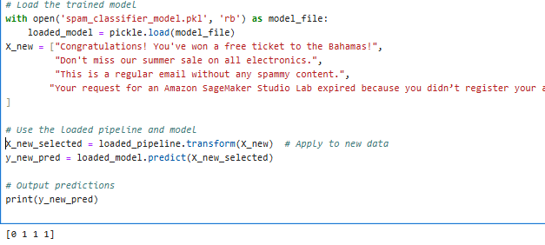
Module 3

Slide 13
Conclusion
The project successfully developed a robust spam email classification model through systematic data preprocessing, feature extraction, and model training, resulting in high accuracy and reliability in distinguishing spam from legitimate emails.
The implementation demonstrates the practical application of machine learning in natural language processing, offering a scalable solution for improving email security and management systems.

Slide 14
Reference
"Machine Learning in Spam Filtering“ – How drugs overcome the barrier (researchgate.net)
"A Comparative Study on Email Spam Classifications Using Machine Learning Techniques" – Recovery methods for 1-bit compressed sensing based on Hamming distance | IEEE Conference Publication | IEEE Xplore
"Data Preprocessing Techniques for Text Mining" - Multi-level Boundary Classification for Information Extraction | SpringerLink

